Slide 1
Microsoft movie studio prospect
Presented by:
Gloria Tisnanga

Slide 2
Microsoft business problem
Microsoft wants to enter the original video content market by creating a new movie studio.
However, they lack experience in movie production.
Your task is to analyze current box office trends to identify the most successful types of films.
Based on your findings, you will provide actionable insights to guide Microsoft's movie production decisions.

Slide 3
Project Overview
: Analyzing Box Office Trends for Microsoft's New Movie Studio

Slide 4
Objective:
Analyze current box office trends.
Identify top-performing film types in terms of audience reception and financial success.
Guide decision-making for film production at Microsoft's new movie studio.

Slide 5
Data was derived from:
https://www.imdb.com/ for analyzing run time and genres
https://www.the-numbers.com/ for analyzing budgets and profitablity

Slide 6
Lead questions
Questions to answer are:
What are the profit and loss margins?
Which is the best rated genre; most profitable genre, genre with highest ratings?
What is the correlation production budget and profitability?
What is the correlation between runtime and production budget?

Slide 7
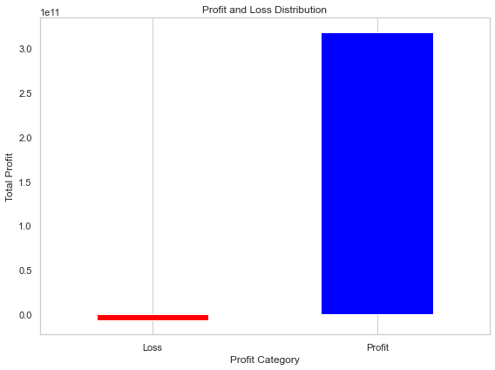
Profitabilty distribution

Slide 8
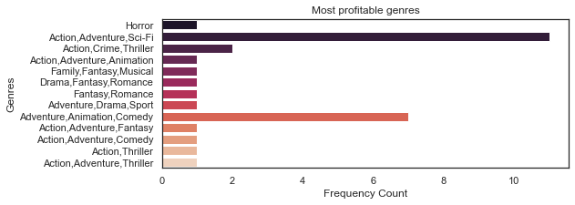
MOST PROFITABLE GENRE: ACTION, ADVENTURE,sci-fi

Slide 9
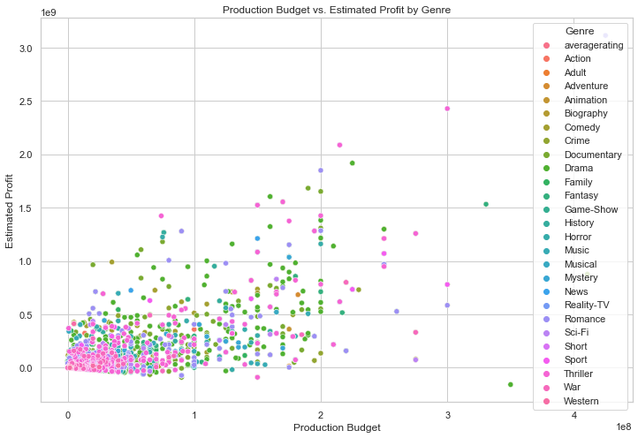
PRODUCTION BUDGET and ESTIMATED PROFIT ANALYSIS

Slide 10
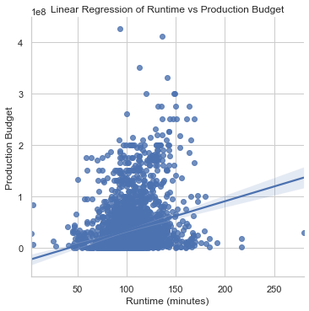
Correlation analysis of runtime and production budget:weak positive correlation between runtime and production budget.

Slide 11
Reccomendations
1.Microsoftstudios can choose to produce either Drama or Action,Adventure,Sci-Fi.
2.Microsoft should leverage on its already existing presence and budget to procure good show writers. A well-written script with strong execution can lead to success even with a lower budget. Invest in script development and focus on high-concept stories with broad appeal.

